Slide 1
The Affordable Care Act in Texas
Elena M. Marks
Episcopal Health Foundation
President and CEO
January 31, 2016

Slide 2
Texas on the Eve of the ACA
Insured and Uninsured
Key
Medicaid Expansion
Adults 138% Federal Poverty Level (FPL) or below
Medicaid Eligible but Unenrolled
Children 200% FPL or below; TANF adults
Subsidy Eligible
Children 201%-400% FPL
Adults ages 0-64 139%-400% FPL
Includes Lawful Permanent Residents (LPRs)
No Subsidy
Children and adults above 400% FPL, including LPRs; adults ages 65+
Undocumented
Children & adults
Medicaid Expansion Adults
24%
Subsidy
Eligible
36%
Uninsured
5,591,000
24%
Medicaid Eligible but Unenrolled
14%
Undocumented
15%
No Subsidy
11%
Note: Due to rounding, percents may not total 100%
Sources: U.S. Census Bureau. March 2011 Current Population Survey (CPS), Texas Health and Human Services Commission, July 2012.

Slide 3
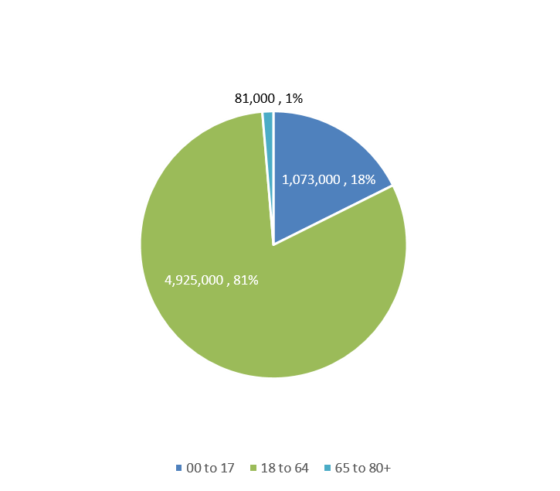
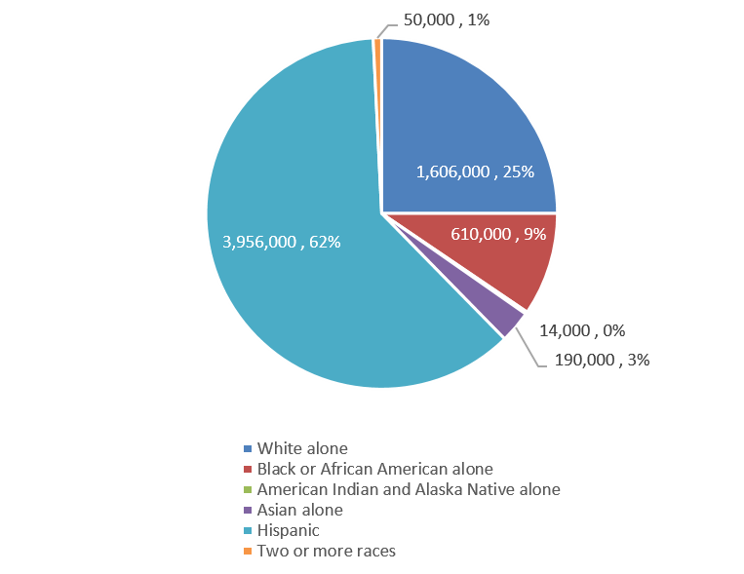
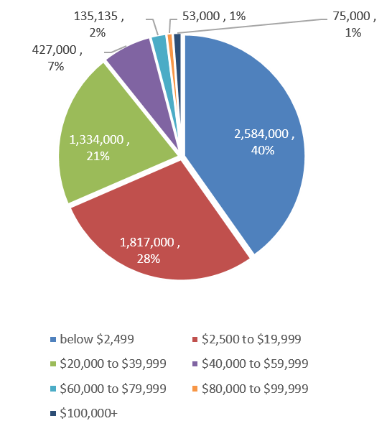
Texas on the Eve of the ACA: Demographics of Uninsured Texans
Uninsured by Race/Ethnicity
Uninsured by Age
Uninsured by Income*
Source: Current Population Survey, Annual Social and Economic Supplement, 2012
U.S. Census Bureau
*Personal Income

Slide 4
Pre-2014 Experiences: Affordability of Care by Insurance Status
Notes:
Source: HRMS September 2013 (IB #1)

Slide 5
Pre-2014 Experiences: Affordability of Care by Income
Notes:
Source: HRMS September 2013 (IB #1)

Slide 6
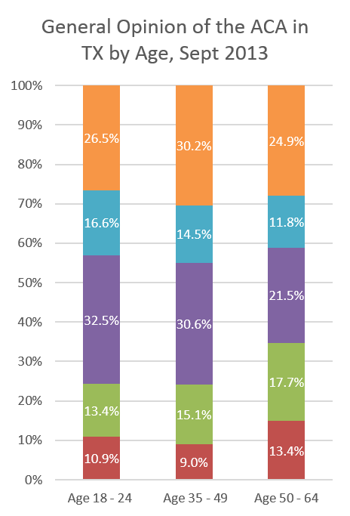
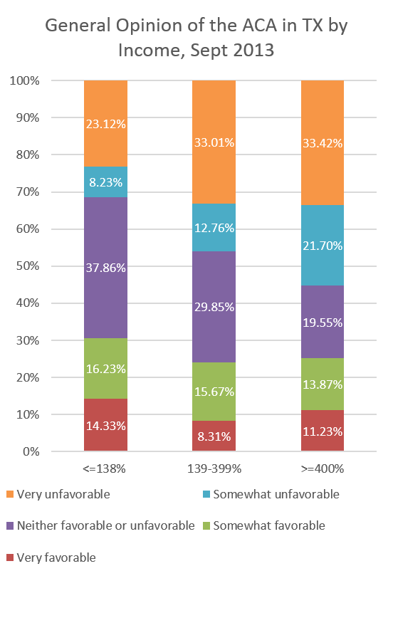
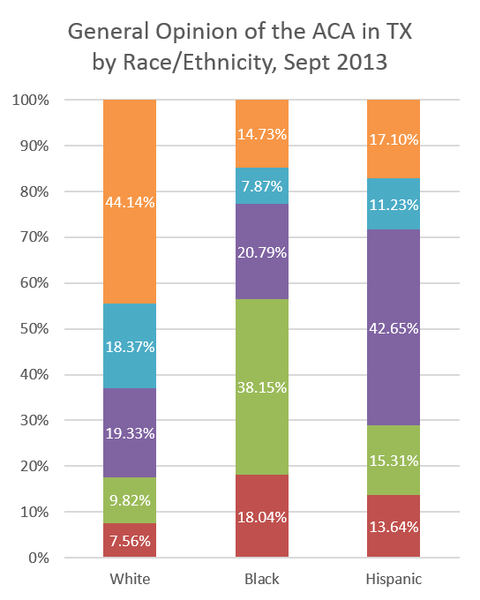
Pre-2014 Experiences: Opinion of the ACA by Age, Income, Race
Notes:
Source: HRMS, September 2013 (IB #2)

Slide 7
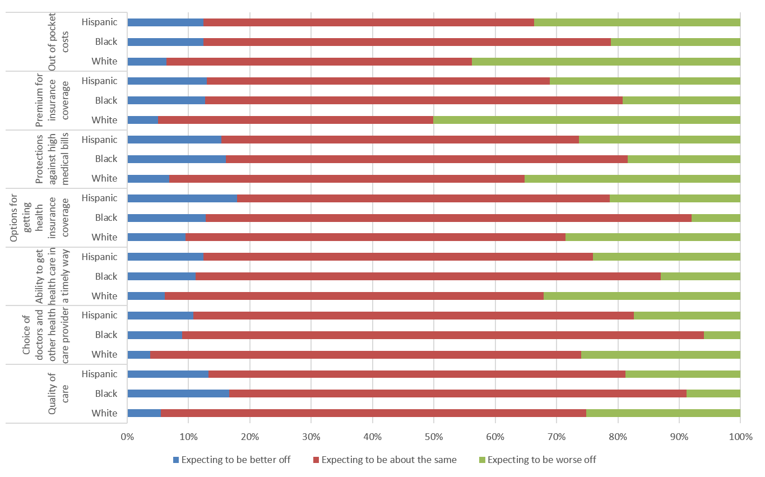
Pre-2014 Experiences: Expectations about ACA
Notes:
Source: HRMS, Sept 2013 (IB #4)

Slide 8
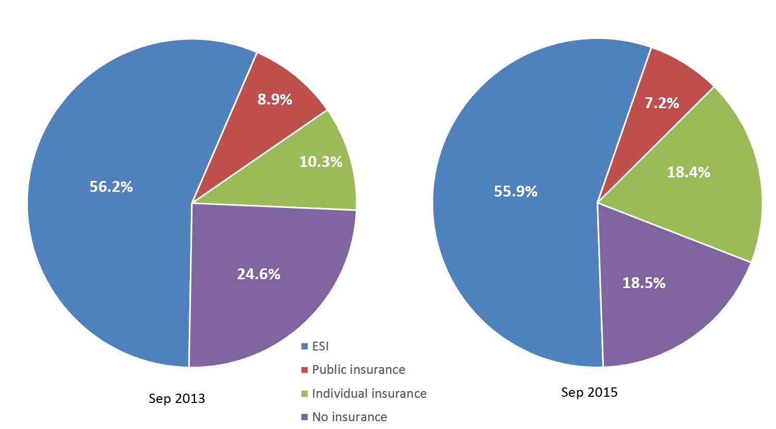
Changes in Insurance Coverage Texans ages 18-64, 2013 to 2015
Notes:
Source: HRMS, Sept 2013 and Sept 2015 (IB #15)

Slide 9
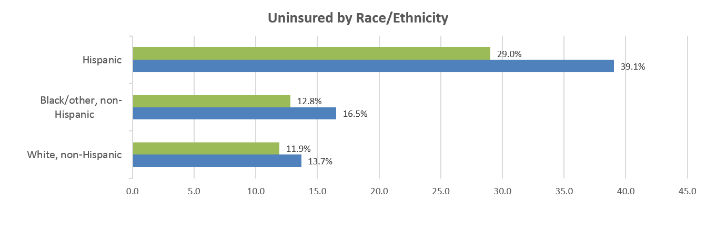
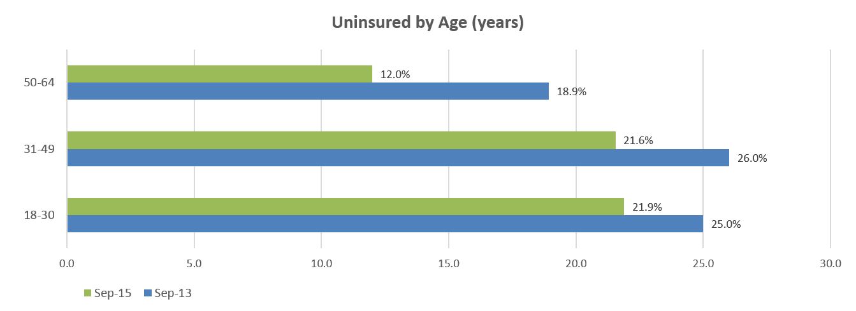
Uninsured by Race/ethnicity and Age Texans ages 18-64, 2013 to 2015
Notes:
Source: HRMS, Sept 2013 and Sept 2015 (IB #16)

Slide 10
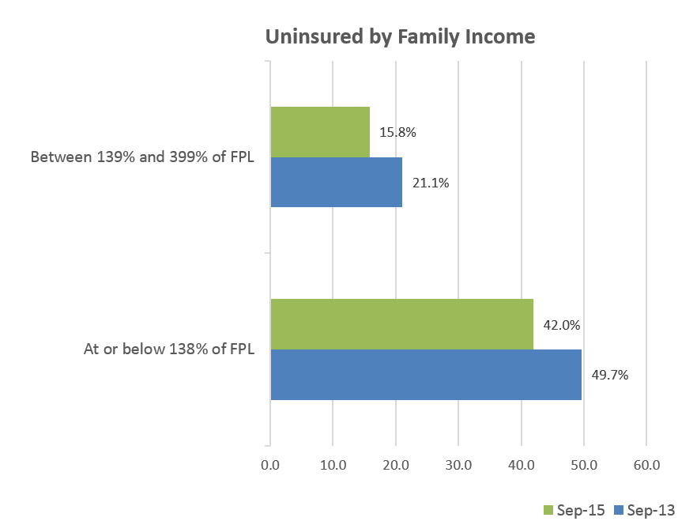
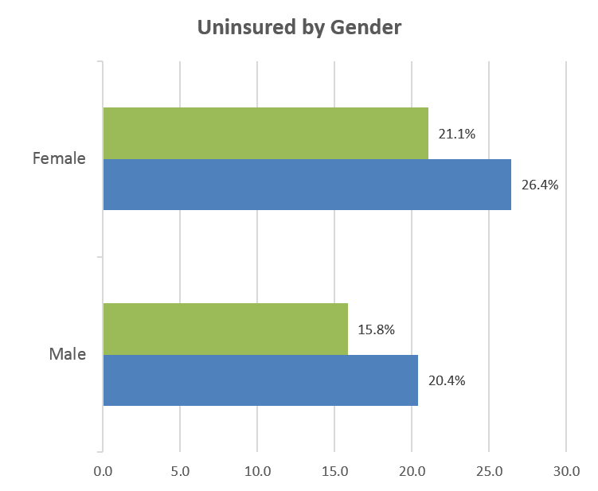
Uninsured by Income and Gender Texans ages 18-64, 2013 to 2015
Notes:
Source: HRMS, Sept 2013 and Sept 2015

Slide 11
Trends in Uninsured Rates 2013 to 2015, Texas and US
Notes:
Source: HRMS, Sept 2013, March 2014, June 2014, March 2015. (IB #11)

Slide 12
Post-2014 Experiences: Reasons for Remaining Uninsured, September 2015
Notes:
Source: HRMS , Sept 2015

Slide 13
Post-2014 Experiences: Reasons for Remaining Uninsured, September 2015
Notes:
Source: HRMS, Sept 2015

Slide 14
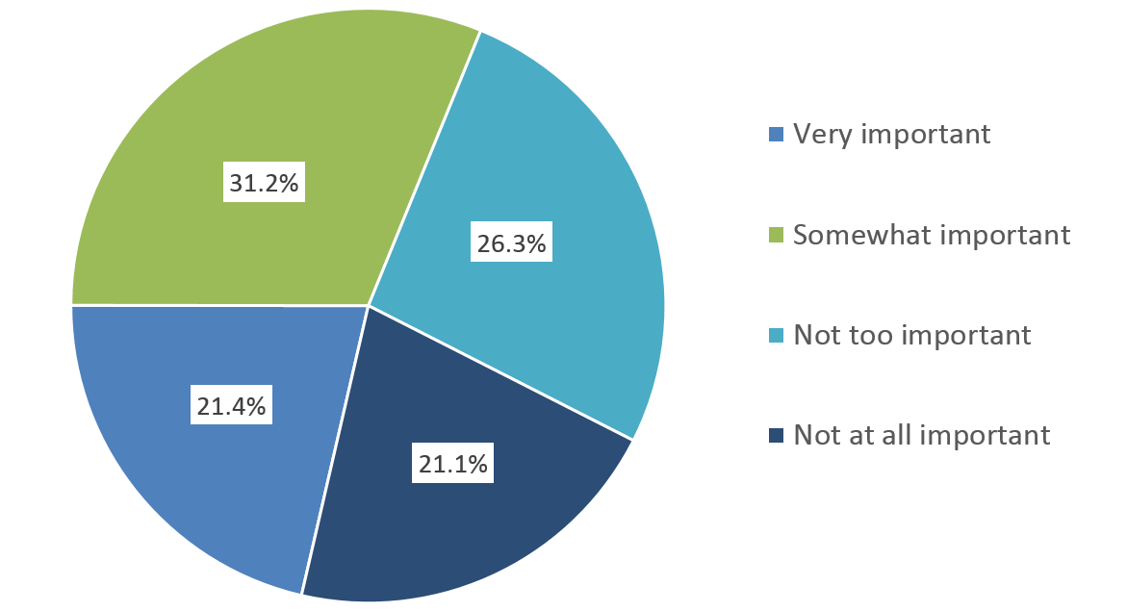
Post-2014 Experiences: Perceptions of Tax Penalties
Importance of the Possibility of a Fine to Uninsured Adult Texans, March 2015
Notes:
Source: HRMS, March 2015 (IB #13)

Slide 15
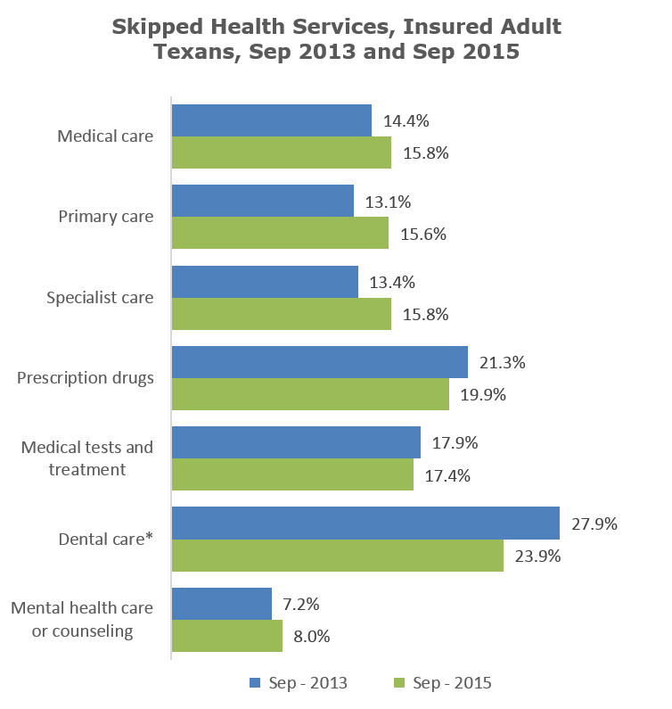
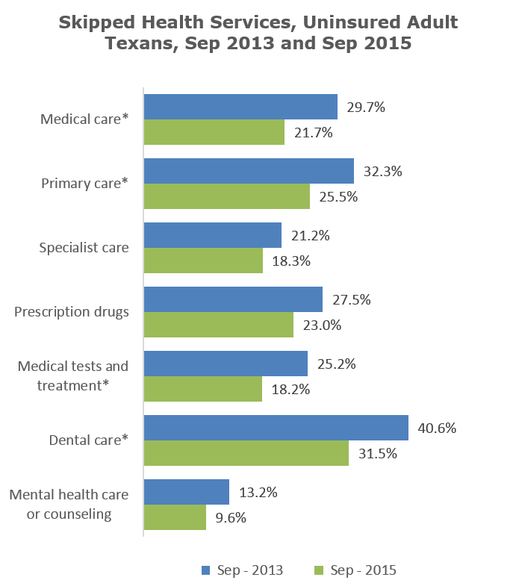
Post-2014 Experiences: Affordability 2013 vs. 2015
Notes:
Source: HRMS, Sept 2013 and Sept 2015 (IB #17)

Slide 16
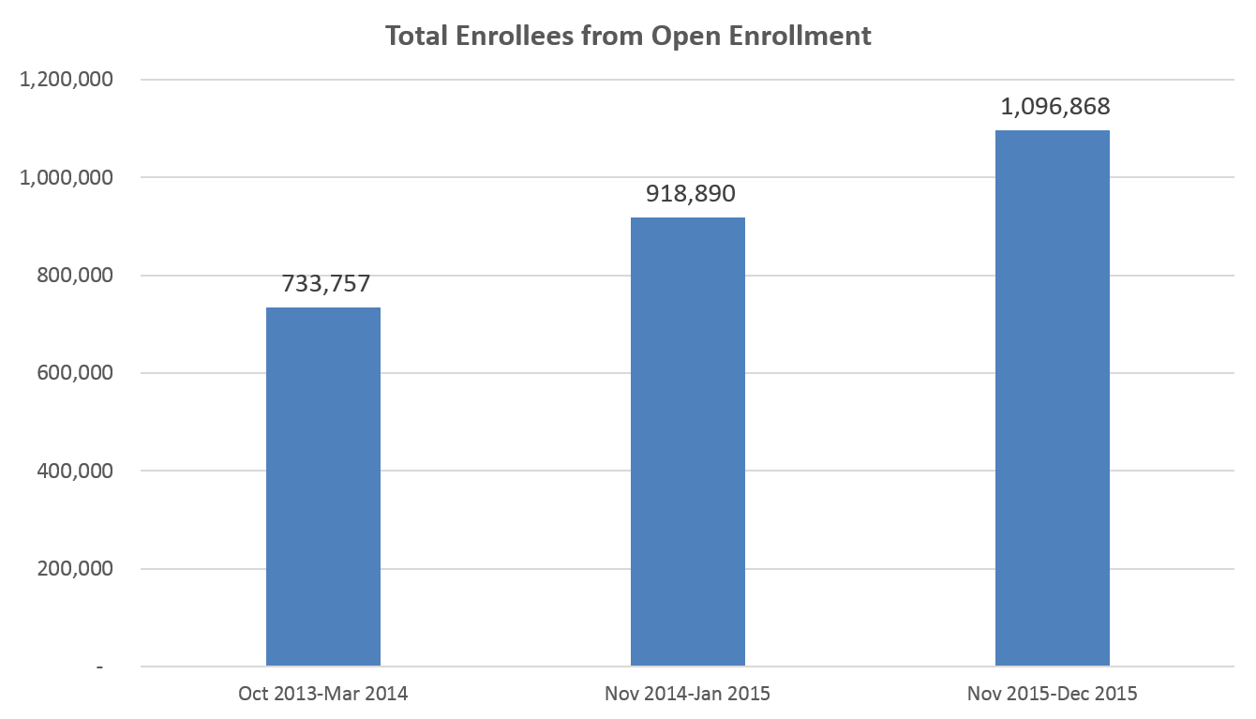
Texans Covered by ACA Marketplace Plans during Open Enrollment Periods
Notes:
Sources: US Department of Health and Human Services. “ASPE Issue Brief Health Insurance Marketplace: Summary Enrollment Report for the Initial Annual Open Enrollment Period For the period October 1, 2013-March 31, 2014.” 1 May 2014. <https://aspe.hhs.gov/sites/default/files/pdf/76876/ib_2014Apr_enrollment.pdf>
US Department of Health and Human Services. “ASPE Issue Brief Health Insurance Marketplace 2015 Open Enrollment Period: January Enrollment Report For the period: November 15, 2014-January 16, 2015.” 27 Jan 2015. <https://aspe.hhs.gov/sites/default/files/pdf/33826/ib_2015jan_enrollment.pdf>
US Department of Health and Human Services. “ASPE Issue Brief Addendum to the Health Insurance Marketplaces 2016 Open Enrollment Period: January Enrollment Report For the period November 1, 2015—December 26, 2015.” 7 Jan 2016. <https://aspe.hhs.gov/sites/default/files/pdf/167986/MarketPlaceAddendumJan2016.pdf>

Slide 17
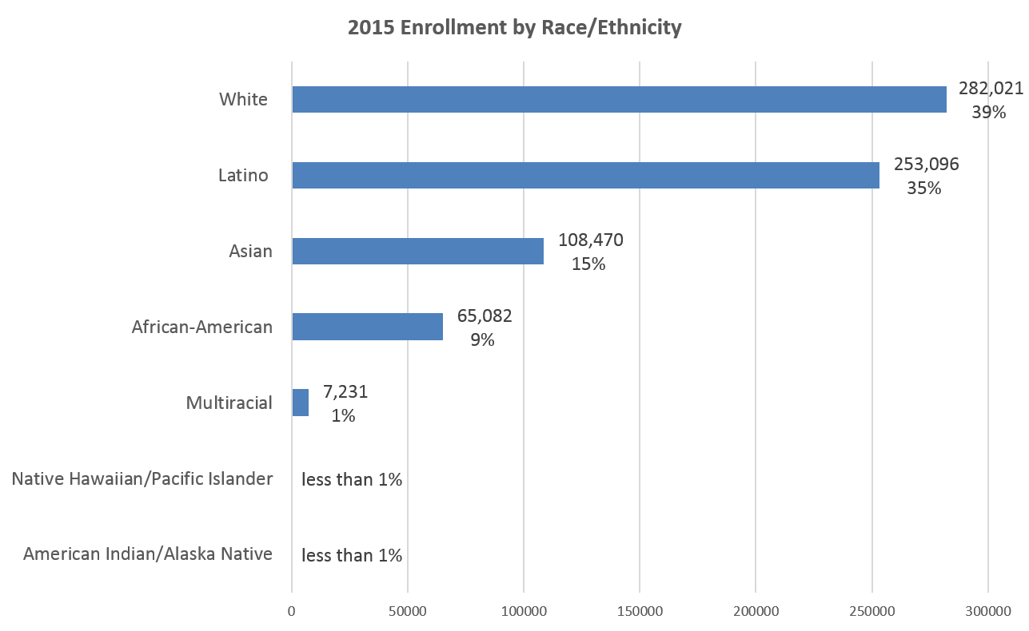
Texas Enrollment in Marketplace Plans By Race/Ethnicity, December 2015
Notes:
Source: US Department of Health and Human Services. “ASPE Issue Brief Addendum to the Health Insurance Marketplaces 2016 Open Enrollment Period: January Enrollment Report For the period November 1, 2015—December 26, 2015.” 7 Jan 2016. <https://aspe.hhs.gov/sites/default/files/pdf/167986/MarketPlaceAddendumJan2016.pdf>

Slide 18
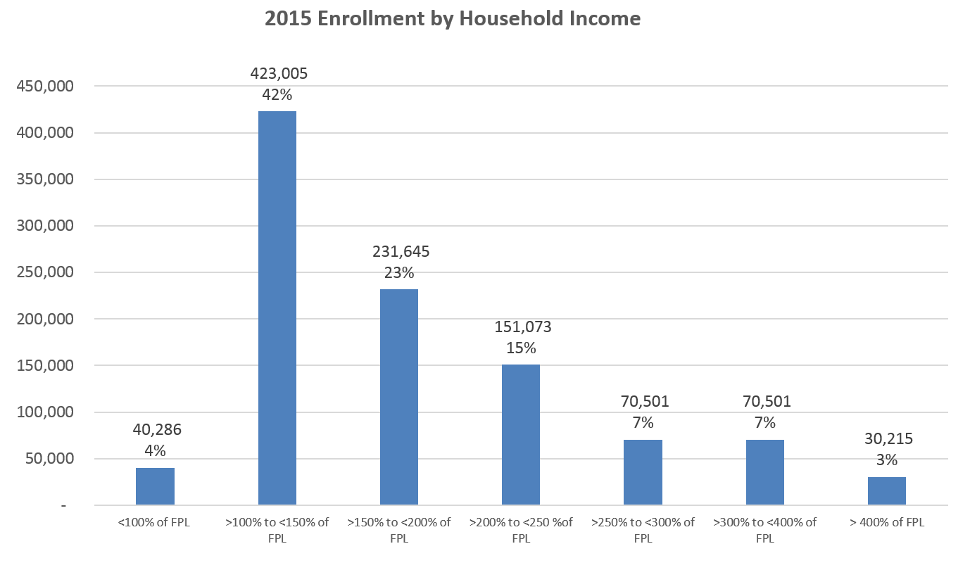
Texas Enrollment in Marketplace Plans by Income, December 2015
Notes:
Source: US Department of Health and Human Services. “ASPE Issue Brief Addendum to the Health Insurance Marketplaces 2016 Open Enrollment Period: January Enrollment Report For the period November 1, 2015—December 26, 2015.” 7 Jan 2016. <https://aspe.hhs.gov/sites/default/files/pdf/167986/MarketPlaceAddendumJan2016.pdf>

Slide 19
ACA and DSH Funding
Fiscal Year | TX DSH Allotment
FY 2010 | $987,947,112
FY 2011 | $956,328,103
FY 2012 | $981,192,634
FY 2013 | $1,004,741,257
FY 2014 | $1,019,812,376
Source: Kaiser Family Foundation Federal Medicaid DSH Allotments-http://kff.org/medicaid/state-indicator/federal-dsh-allotments/
Fiscal Year | Decrease in National Federal DSH Funding
FY 2018 | $2.0 billion
FY 2019 | $3.0 billion
FY 2020 | $4.0 billion
FY 2021 | $5.0 billion
FY 2022 | $6.0 billion
FY 2023 | $7.0 billion
FY 2024 | $8.0 billion
Source: Medicaid and CHIP Payment and Access Commission--https://www.macpac.gov/subtopic/disproportionate-share-hospital-payments/
Notes:
When the ACA was enacted, it was assumed that all states would expand Medicaid coverage up to 133 percent of the federal poverty level. However, after the U.S. Supreme Court’s decision in June 2012, the Medicaid expansion for non-disabled adults effectively became optional for states. CMS developed its reduction methodology for FY 2014 and 2015 only in recognition of the fact that current data regarding states’ levels of uninsurance would not yet reflect their decisions regarding Medicaid expansion. Depending on the methodology that is adopted for FY 2017 and beyond, non-expansion states, which will have higher levels of uninsurance, may be subject to lower DSH reductions, while states that decided to expand the Medicaid programs may realize more significant DSH reductions. (MACPAC--https://www.macpac.gov/subtopic/disproportionate-share-hospital-payments/)

Slide 20
ACA and FQHCs
ACA established 5-year, $11-billion trust fund to support health center growth and new construction
$1.5 billion to expand the National Health Service Corps (NHSC)
Higher enrollment in Medicaid under ACA potentially generating increased revenues for centers
Notes:
Source: Shin, Peter, Jessica Sharac, Zoe Barber, Sara Rosenbaum, Julia Paradise. “Community Health Centers: A 2013 Profile and Prospects as ACA Implementation Proceeds.” Kaiser Family Foundation. 17 Mar 2015. <http://kff.org/report-section/community-health-centers-a-2013-profile-and-prospects-as-aca-implementation-proceeds-issue-brief/>

Slide 21
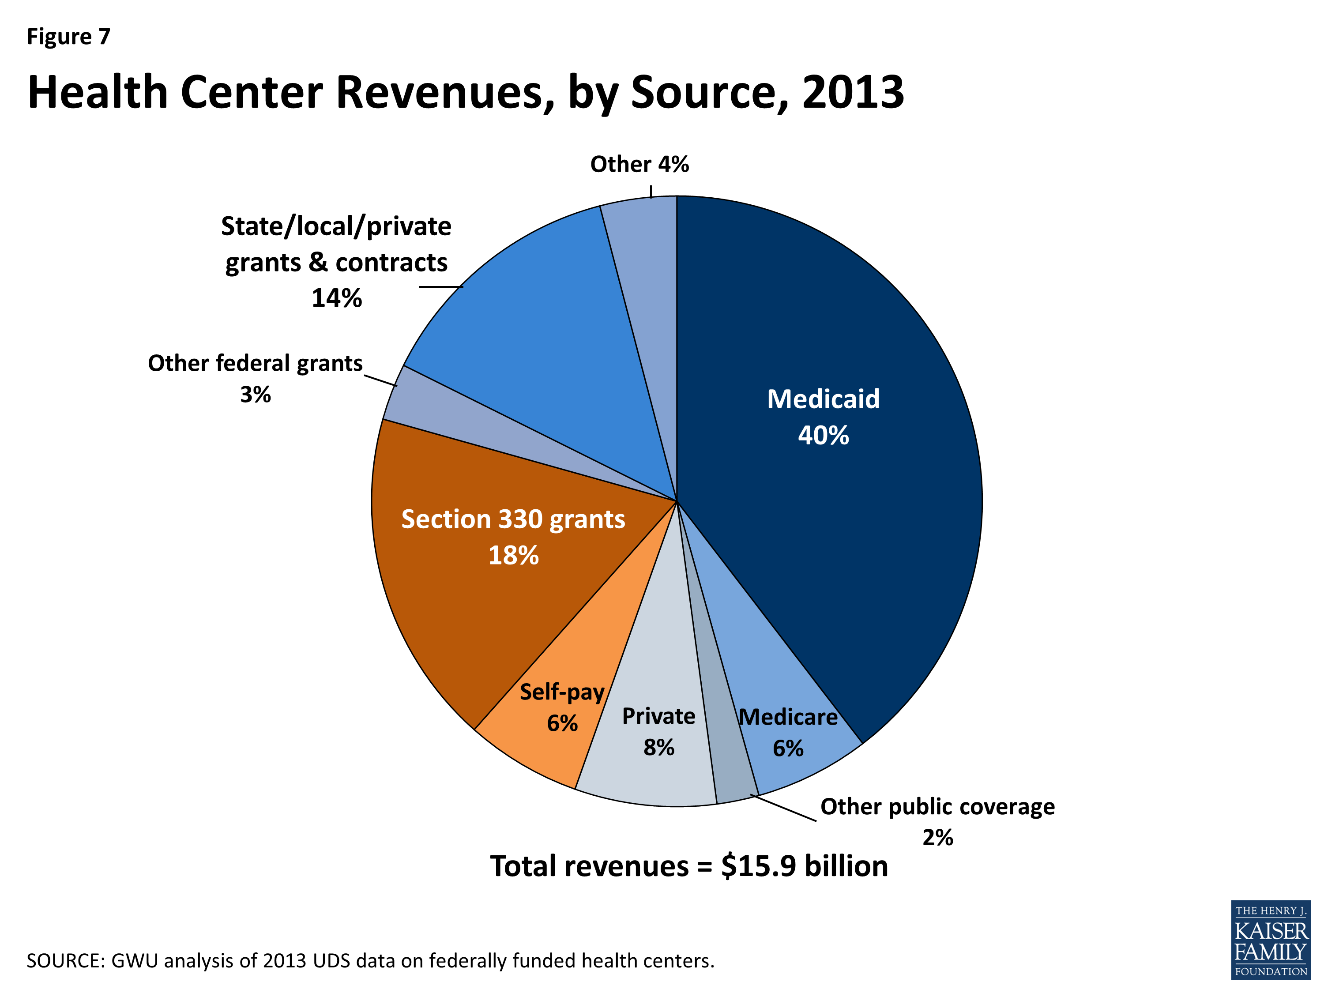
ACA and FQHCs
Notes:
Source: Shin, Peter, Jessica Sharac, Zoe Barber, Sara Rosenbaum, Julia Paradise. “Community Health Centers: A 2013 Profile and Prospects as ACA Implementation Proceeds.” Kaiser Family Foundation. 17 Mar 2015. <http://kff.org/report-section/community-health-centers-a-2013-profile-and-prospects-as-aca-implementation-proceeds-issue-brief/>
State Medicaid expansion decisions have a separate, additional impact on health centers. States that expand Medicaid provide comprehensive benefits for low-income nonelderly adults, ensuring payment for health centers that serve these patients and enhancing their ability to furnish or arrange for a broader range of services. As outlined earlier, in 2013, a majority of health center patients were working-age adults (61%). Over 70% had income at or below 100% FPL and 35% were uninsured. This profile closely matches the target population for the ACA expansion of Medicaid. Thus, state decisions to expand Medicaid could have a large positive impact on access to coverage for adult health center patients. In the 29 states (including DC) that have expanded Medicaid to date, many poor, previously uninsured health center patients have now gained access to Medicaid coverage.

Slide 22
ACA and FQHCs: 2013 to 2014 Findings
In 2014, health centers served 22.5 million patients – an increase of nearly 1.2 million from 2013
From 2013 to 2014, the number of health center patients covered by Medicaid rose by 1.85 million, or 22%
Health centers in expansion states were significantly more likely than those in non-expansion states to report having expanded their capacity for dental and mental health services since the start of 2014
Notes:
Source: Shin, Peter, Jessica Sharac, Julia Zur, Sara Rosenbaum, Julia Paradise. “Health Center Patient Trends, Enrollment Activities, and Service Capacity: Recent Experience in Medicaid Expansion and Non-Expansion States.” 2 Dec 2015. <http://kff.org/medicaid/issue-brief/health-center-patient-trends-enrollment-activities-and-service-capacity-recent-experience-in-medicaid-expansion-and-non-expansion-states/>

Slide 23
ACA and FQHCs: 2013 to 2014 Findings
Notes:
Source: Shin, Peter, Jessica Sharac, Zoe Barber, Sara Rosenbaum, Julia Paradise. “Community Health Centers: A 2013 Profile and Prospects as ACA Implementation Proceeds.” Kaiser Family Foundation. 17 Mar 2015. <http://kff.org/report-section/community-health-centers-a-2013-profile-and-prospects-as-aca-implementation-proceeds-issue-brief/>
Between 2013 and 2014, the share of health center patients covered by Medicaid rose from 40% to 46%, the share with private insurance rose from 14% to 16%, and the share who were uninsured declined from 35% to 28%.
Changes in health center patient coverage were sharply different between Medicaid expansion and non-expansion states (Figure ES-1). In expansion states, the share of patients with Medicaid rose by 20% and the share who were uninsured fell by 29%. In non-expansion states, the share with Medicaid rose by 3% and the share who were uninsured fell by 8%. Private coverage rates remained low in both groups of states because most health center patients have income below the poverty level and are thus ineligible for Marketplace subsidies.

Slide 24
ACA and Community Benefits
501(c)r:
Establish written financial assistance and emergency medical care policies
limit amounts charged for emergency care to individuals eligible for financial assistance
make reasonable efforts to determine whether an individual is eligible for assistance before extraordinary collection actions
conduct a CHNA and adopt an implementation strategy at least once every three years.
Notes:
Source: Community Benefit and the ACA: A Brief History and Update (Rosenbaum, Byrnes, Hurt)
IRC Section 501(c)r <https://www.law.cornell.edu/uscode/text/26/501>
(section amending pre-existing 501(c)3 requirements for hospitals)

Slide 25
ACA and Community Benefits: Definitions
From Schedule H:
hospital participation in Medicaid and other means-tested public insurance programs that pay less than the reasonable cost of care
health professions education and health research
community health improvement activities; certain “community-building” activities when these activities can be shown to be interventions that are known to improve community health.
Notes:
Sources: Rosenbaum, Sara, Maureen Byrnes and Nikki Hurt. “Community Benefit and the ACA: A Brief History and Update.” The George Washington University Department of Health Policy. <http://www.nchh.org/Portals/0/Contents/HCF_CBACA%20overview.pdf>
IRS Form Schedule H (Form 990) <https://www.irs.gov/pub/irs-pdf/f990sh.pdf>

Slide 26
ACA and Community Benefits: CHNA
Purpose:
create a system by which hospitals continually and publicly assess community health needs
devise implementation strategies that demonstrate how their community benefit expenditures link to publicly identified community health needs
Notes:
Source: Rosenbaum, Sara, Maureen Byrnes and Nikki Hurt. “Community Benefit and the ACA: A Brief History and Update.” The George Washington University Department of Health Policy. <http://www.nchh.org/Portals/0/Contents/HCF_CBACA%20overview.pdf>
The CHNA process consists of two distinct phases. The first phase is a “community health needs assessment” that meets the requirements of the law. The second phase is an “implementation strategy” whose purpose is to describe “how the organization is addressing the needs identified in each community health needs assessment,” as well as “any such needs that are not being addressed together with the reasons why such needs are not being addressed.”
CHNAs require
A description of the community served by the hospital facility and how it was determined.
A description of the process and methods used to conduct the CHNA, including citation information, analytical methods used to identify community health needs, and gaps in information impacting assessment.
A description of how the hospital organization took into account input from persons representing the broad interest of the community served by the hospital facility. The IRS understands this to mean: (1) persons with expertise in public health; (2) federal, tribal, regional, state, or local health departments or agencies; and (3) leaders, representatives, or members of medically underserved, low-income, chronically ill, and minority populations.
A prioritized description of all the community health needs identified through the CHNA, and the process and criteria that determined prioritization.
A description of the existing health care facilities and other resources within the community available to meet the identified community health needs.

Slide 27
Future of the ACA: Political Climate
Aside from Repeal and Replace:
Alter conditions on new Medicaid recipients to limit eligibility
Weaken the individual mandate through eased access to federal waivers
Create waiver programs to let states undo or weaken regulatory reforms
Notes:
Beland, Daniel, Philip Rocco and Alex Waddan. “Here’s Three Easy Ways a Republican President Could Dismantle the ACA—Short of Outright Repeal.” The Washington Post. 26 Jan 2016. <https://www.washingtonpost.com/news/monkey-cage/wp/2016/01/26/heres-three-easy-ways-a-republican-president-could-dismantle-the-aca-short-of-outright-repeal/>

